Slide 1


Git & GitHub
Session 4
Authored by : Omar Shehata

Slide 2



But Now we have VCS ( Version Control System )
Ahmed
Mohamed
project
Farouk

Slide 3
Version Control system
What’s version control system ?
It’s simply a system, that solve all the previous problems we have found
So, it make the teamwork easier, it enable the management of different versions
recovering from accidental deletions or edits.
Types of VCS
Local VCS
Centralized VCS
Distributed VCS

Slide 4


Distributed VCS
Snap Shot
Ahmed
Mohamed
Repo
V1
V2
V3
V1
V2
Repo
Farouk
Tools that use distributed VCS:
Git
Mercurial
V1
V2
Repo

Slide 5

Git
it was created by Linus Torvalds (creator of Linux), and he made it to manage Linux development community
It’s a CLI tool, but now there’s a GUI version too.
There are some concepts that need to be known :
repo – repository – depot : It’s a directory structure that holds all the project history and events. And this directory called “.git”
Working directory : the Directory that holds the whole project. The directory that contain the .git
index – staging area : area between the working directory and the repo

Slide 6
Commit : the process of saving any changes in local repo
Cloning : get a copy from remote repo
Push : push the changes to the remote repo
Pull : pull any changes happened in the remote repo
Check out : go to other versions or snapshots for the repo
every snapshot is saved in the repo with a (SHA1 hash value , 40-hex digits ) representing it. but also, there’s another way to represent a specific snapshot, using “Branches or Tags”
Farouk
Mohamed
V1
Repo
V2
Repo

Slide 7

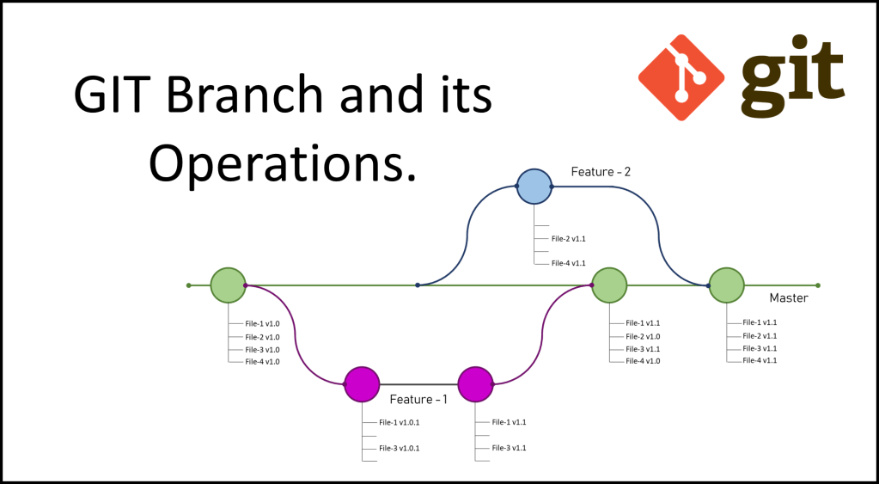


Branches
it’s used to take a “copy” from the whole project at specific point, to deal with it as you want. Then return the changes you made to the main branch “master branch” back after merging .
the branch is just a pointer to specific commit.

Slide 8

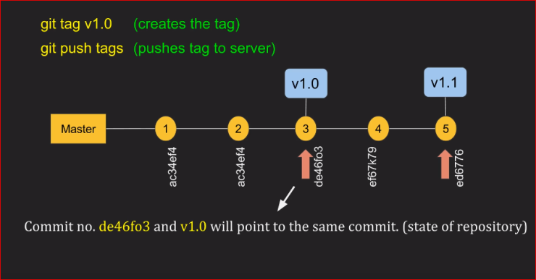
Tags
It’s a reference to a specific commit within the history of a Git repository
It’s often used to mark a release, or “snapshot”.
It may help to not use the commit hash to check out it.

Slide 9

Staging area
It’s the area between the repo and the working directory.
You have to go through it to before committing any thing in the repo
It’s useful because it help in committing many changes at the same time
Working directory
Staging area - index
repo

Slide 10
Commands we need
git init
git status
git commit
git clone
git log
git branch <branch name>
git tag <tag name>
git checkout <checksum or tag or branch>
git push <the remote repo name> <the branch or tag name>
git pull <the remote repo name> <the branch>
git config –global user.name < the name> # global may replaced with –system to apply the changes to the whole machine)
git config –global user.email <the email> # global may replaced with –system to apply the changes to the whole machine)
git merge <branch one> <branch two>

Slide 11
Now let’s go practical
A whole scenario (init, add, commit, log, another commit, checkout, branch, tag)
Push it to remote repo (GitHub)
Clone the repo at another location
Solve the first part of the “IEEE_FIRST_TEST”

Slide 12
ANY QUESTIONS ?

